Slide 2
Cost/Benefit Analysis
The process of isolating and estimating costs and benefits
In order to do a cost-benefit analysis, two sides of the ledger must be considered
System costs
Benefits from the system
If a system is economically feasible, then the benefits should outweigh the system costs within a defined period of time acceptable to the user/client

Slide 3
Cost
One time
Recurring

Slide 4
Benefits
Normally increase profits or decrease costs
Performance benefits
Cost avoidance benefit
Tangible Benefits
Intangible Benefits

Slide 5
Technique used to determine economic feasibility
Four different method
Payback analysis
Return on investment
Net present value
Profitability index

Slide 6
Payback analysis
determines how much time will lapse before accrued benefits overtake accrued and continuing costs
Time required for investment to break even
Very important when company is 'cash poor' - shows when company will get its money back
Does not consider the 'time value' of money!
A new project continues to go into debt until it is implemented and benefits begin to be realized
Breakeven point is when debts have been cancelled by benefits

Slide 7
Payback Period
Payback Period(T) = Development Costs (D)/Annual revenues – Annual operation costs
Investment A costs $40,000 to develop and reduces costs by $20,000 annually. Payback period is D/P = $40,000/$20,000 = 2 years

Slide 8
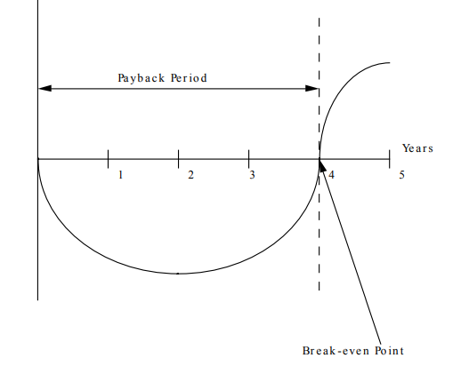
Payback Period

